Slide 1


POC Event Driven microservices architecture
BUSINESS NEED
SOLUTION
Distributed tracing with SLF4J MDC, Spring Cloud Sleuth and Zipkin
Log aggregation with ELK stack (Elasticsearch, Logstash and Kibana)
Messaging between microservices using Kafka
Real time analytics and store in Postgresql
Monitoring solution using Micrometer, Prometheus and Grafana.
CQRS with Kafka and Elastic search
Service Registration and Discovery with Spring Cloud and Netflix Eureka
HIGHLIGHTS
Combining EDA and microservices, build highly distributed, scalable, available, fault-tolerant, and extensible systems that are capable of consuming, processing, aggregating, and correlating large amounts of events or information, in real-time.
Microservices promise to help break down monolithic applications and enable the consistent delivery of services. But they can't do the job without support. This is where event-driven architecture (EDA) comes into play.
Capturing events from various sources (database, object stores, HTTP, etc.)
Maintaining a configurable mapping on the webhooks to call for each event.
Hitting the endpoints with the respective payloads.
Handling automatic retries, timeouts, and even rescheduling of the same event in case of long-lived outages
Massively scalable. As long as your eventing system can take the load, you can process millions of queries per second.

Slide 2

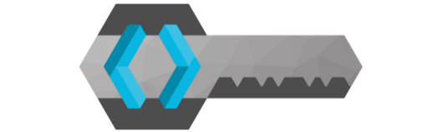





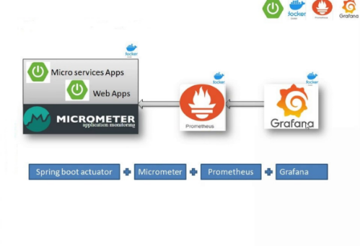
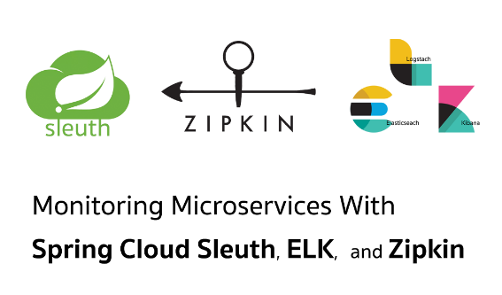
Config-Server
API-gateway
Discovery-Service
(Spring Cloud Config)
(Spring Cloud gateway)
(Netflix-Eureka)
Authz-Server
(Keycloak)
Source
(Twitter)
Twitter-to-Kafka
(Microservice)
Event-Store
(Kafka)
Kafka-to-Elastic
(Microservice)
Query-Store
(Elasticsearch)
Query-Service
(Microservice)
web-client
(Microservice)
Monitoring &
Visualization
Log-Aggregation &
Visualization
Kafka-Streams
(Microservice)
Analytics
(Microservice)
Analytics Store

Slide 3
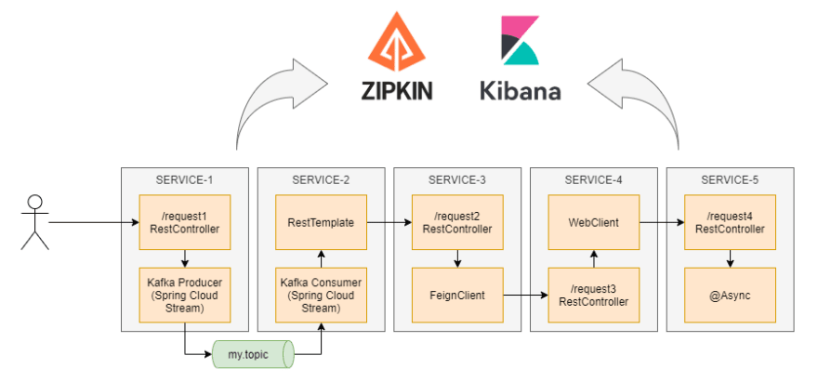
Internal Flow of Spring Cloud Sleuth, Logstash, Zipkin and Kibana

Slide 4
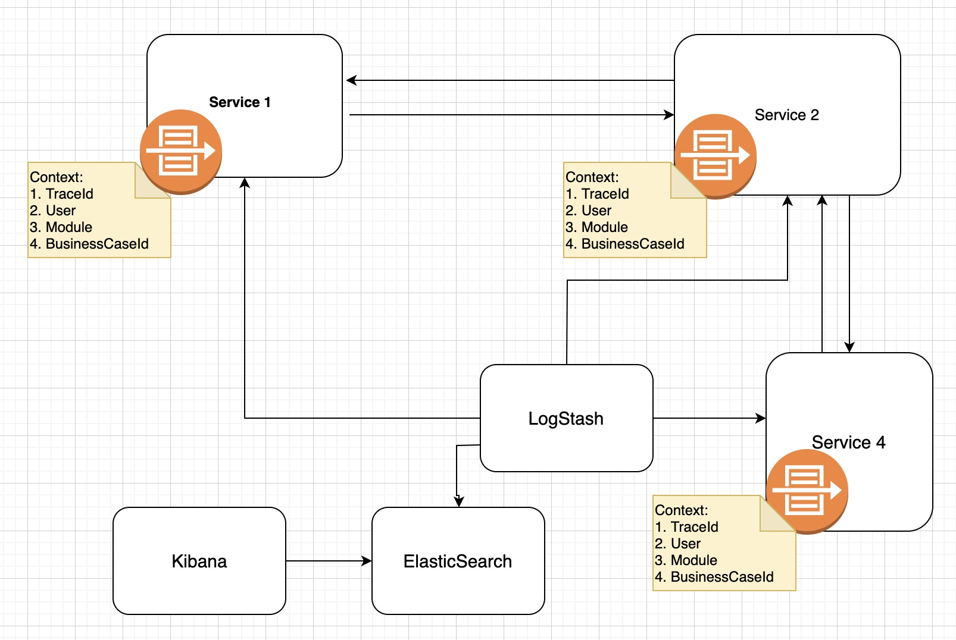
Log Tracing with TraceID & SpanID using Spring Cloud Sleuth, Logstash, Zipkin and Kibana

Slide 5
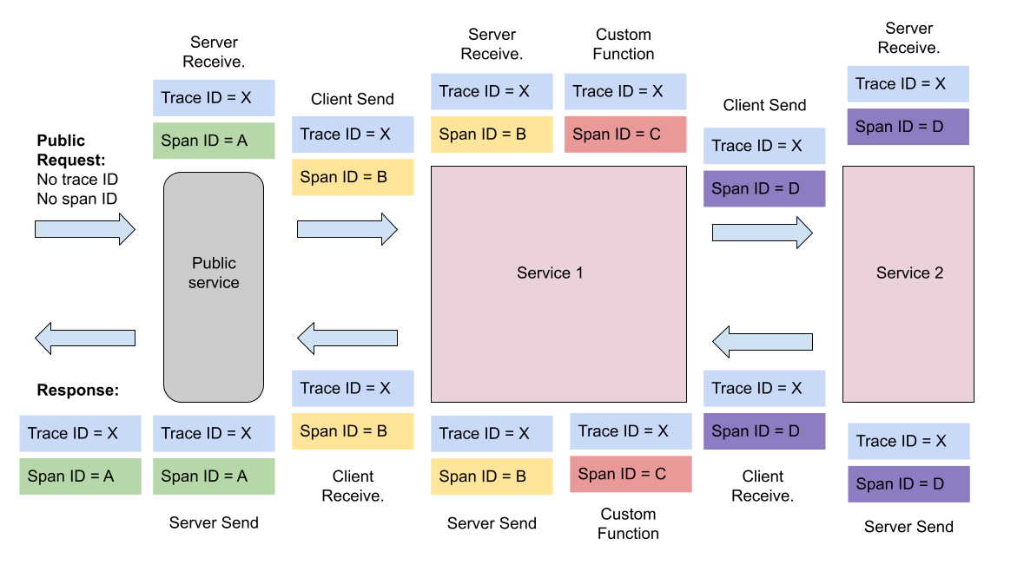
High level distributed log tracing Architecture

Slide 6
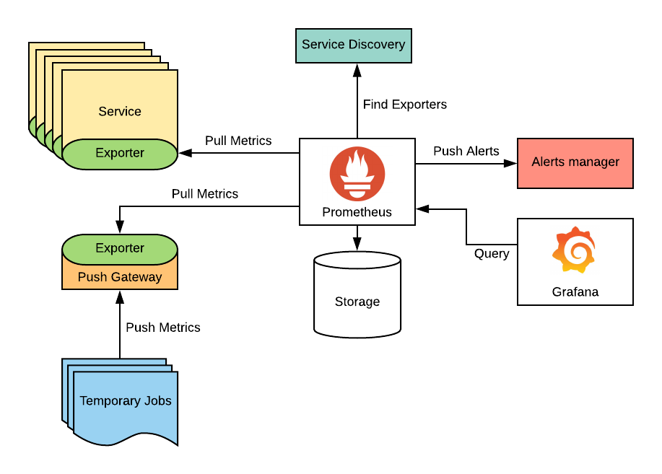
Architecture of Monitoring with Springboot Actuator, Micrometer, Prometheus and Grafana

